Slide 1
Ms. Pooni (A-G) Mr. Sall (H-Q) Ms. Schlatter (R-Z)
Course Selection 2019/2020
Grade 10 to 11

Slide 2
Graduation Requirements
A Math 10
A Math 11
Numeracy Assessment (10, 11 or 12)
Socials 10
A Socials 11 or 12
Science 10
A Science 11
PHE 10
Career Life Education 11
English 10
An English 11
English Studies 12
Literacy Assessment (Gr. 10 & 12
3 other Grade 12 Courses
Career Life Connections 12
5 electives in Gr. 10 - 12* (1 must be Arts Education or Applied Design, Skills and Technologies)

Slide 3
How to get credits…
Courses taken at school
Online Courses
Summer School
External Credits:
Music, Dance,…
Drivers Ed Course
Sports (Regional+)
Cadets, Lifeguard,…
Work Experience or Trades Programs
Language Challenge
Register in October, write in Jan/Feb
Language from other country
Gr. 7-9 schooled in another language

Slide 4
New Media 11
English 10
English Studies 12
Creative Writing 11
Literary Studies 11

Slide 5
*Social Studies 11
*Human Geography 12
Psychology 11
*World History 12
Psychology 12
Socials 10
*BC 1st Peoples 12
*Law 12
*
*Social Justice 12

Slide 6
Earth Science 11
Science for Citizens 11
Science 10
Physics 11
Physics 12
Chemistry 11
Chemistry 12
Life Sciences 11
Life Sciences 12

Slide 7
*Trades & most entry level jobs
Workplace Math 10
*Workplace 11
Math 9
Foundations 11
Foundations 12
Foundations & Pre-Calculus 10
Pre-Calculus 12
Pre-Calculus 11
Calculus 12

Slide 8
Active Living 11 (PHE 11)
Active Living12 (PHE12)
PHE 10 (required)
Fit for Life 11 (girls)
Fit for Life 12 (girls)
Physical & Health Education 9
FITNESS AND CONDITIONING 11
FITNESS AND CONDITIONING 12
LEADERSHIP (Raider Connect)

Slide 9
Making decisions about courses….

Slide 10
Do I Need a 2nd Language?
A second language is not required for graduation
2nd language in Grade 11 may be required for University entrance, if apply straight from high school
UBC: Language 11 (French 11, Spanish 11, Punjabi 11…)
SFU: Intro 11 (Spanish 11 Beginners) or Language 11
Most Apprenticeships, Trade Programs do not require 2nd language
Language Challenge – apply in October

Slide 11
French 9
French 10
French 11
French 12
Spanish
Intro Spanish 11
Spanish 11
Spanish 12

Slide 12
Business Education
Marketing 12
Accounting 11/12
Entrepreneurship 12

Slide 13
Home Economics
Foods Studies 11/12
Child Dev. and Caregiving (Family Studies 12)
Textiles 11/12

Slide 14
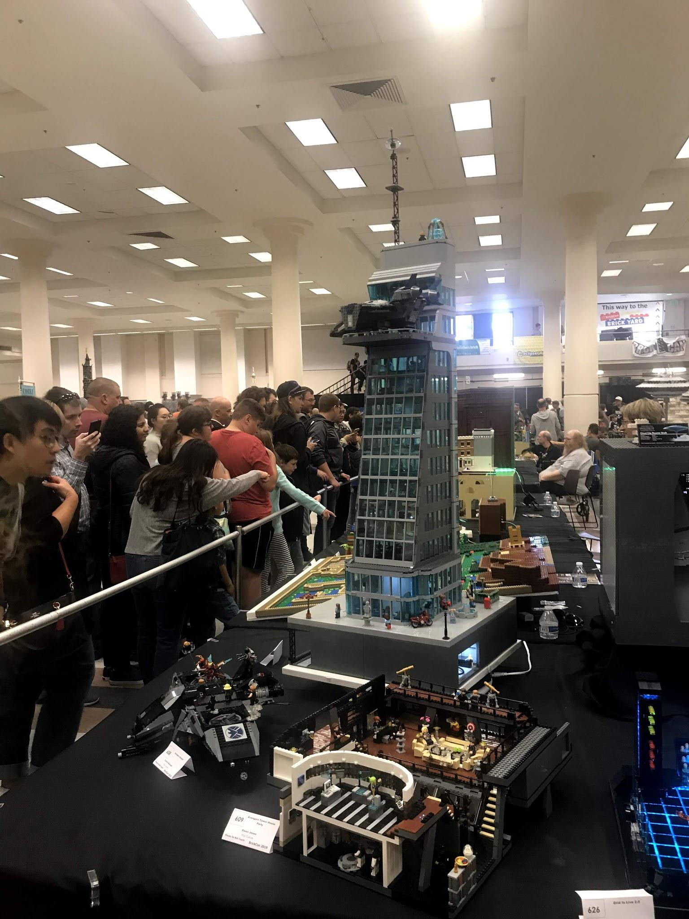
Technology Education
Woodwork 11/12
Drafting and Design 11/12
Metal 11/12
Engineering 11/12

Slide 15
Media Arts
Media Design 11/12
Computer Animation 11-12
Film & TV 11/12
Media Arts(Yearbook) 11/12(after school)

Slide 16
Visual Arts
Arts Studio 11/12
(General art)
Studio Art 2D
(Drawing & Painting 11/12)
Studio Art 3D
(Ceramics & Sculpture 11/12)

Slide 17
Performing Arts
Drama
Music
Drama (Acting) 11/12
Theatre Production 11/12
X-Block- after school
Theatre Company 11/12
X-Block- after school
Band 11/12
X-Block
Guitar/Piano 11/12
Musical Theatre 11/12
Dance 11/12

Slide 18
Help Others
Get Help
Peer Tutoring 11/12
Application process
Leadership 11/12
Application process
Library 11/12
Strategies for Learning 11/12
LA/LD
There is a process for being referred
ELL 11/12
Speak to Ms. Faryna if you need more ELL courses next year

Slide 19
NOTE
Gr.11 courses are often prerequisites for Gr.12 courses, so plan ahead
Make informed and realistic requests
(1) Grad Requirements, then (2) Post Secondary requirements
Keep Counsellor informed of changes & plans (ex. Summer School, online)

Slide 20
Grade 11 Course Selection
Number of Courses:
Students must select at LEAST 8 courses in their schedule
You can take a 9th course outside of regular school hours. Students who take a 9th course outside of regular hours can see their counsellor to see if they can have a study block in lieu.
REQUIRED COURSES: Students must select at LEAST 1 course from EACH of these REQUIRED areas: English, Math, Socials Studies, Science & Career Life Education.

Slide 21
ELECTIVE COURSES: After selecting REQUIRED courses, students select their 3 ELECTIVES. Students must select 3 to complete their schedule
ALTERNATE COURSES: Students must select 2 courses from the alternates list due to timetable constraints, these may be used in place of your electives.
STUDENT SERVICES: Students who were in a SS program (ELL, LST,CARES, FOCUS or SLP) please select STUDENT SERVICES 11 as an elective course.

Slide 22
Password Requirements
Minimum length 8
At least 1 capital letter
At least 1 symbol that isn’t a letter/number. Ie. $,%,!
Can’t contain first,middle, last name, date of birth, personal id or the word “password”
Example of acceptable password would be “$Delview20”

