Slide 1
Grad 2025
Delview Secondary

Slide 2
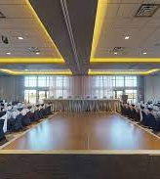
2025 Dinner Dance
Date: May 23, 2025
Time: 5:30-10:30
Location: Tsawwassen Springs Golf Course
Cost: $150 (Reminder that all school fees must be paid prior to purchasing a banquet ticket. Please contact Ms. Goltz in the Delview office for any questions regarding student fees).
Information: Students will leave Delview and make their way to Tsawwassen Springs for their 2025 Dinner Dance Banquet. Doors open at 5:30

Slide 3
TICKET SALES
DINNER/DANCE
APRIL 28th-MAY 2nd
(Sold at the office)
Cost $150

Slide 4
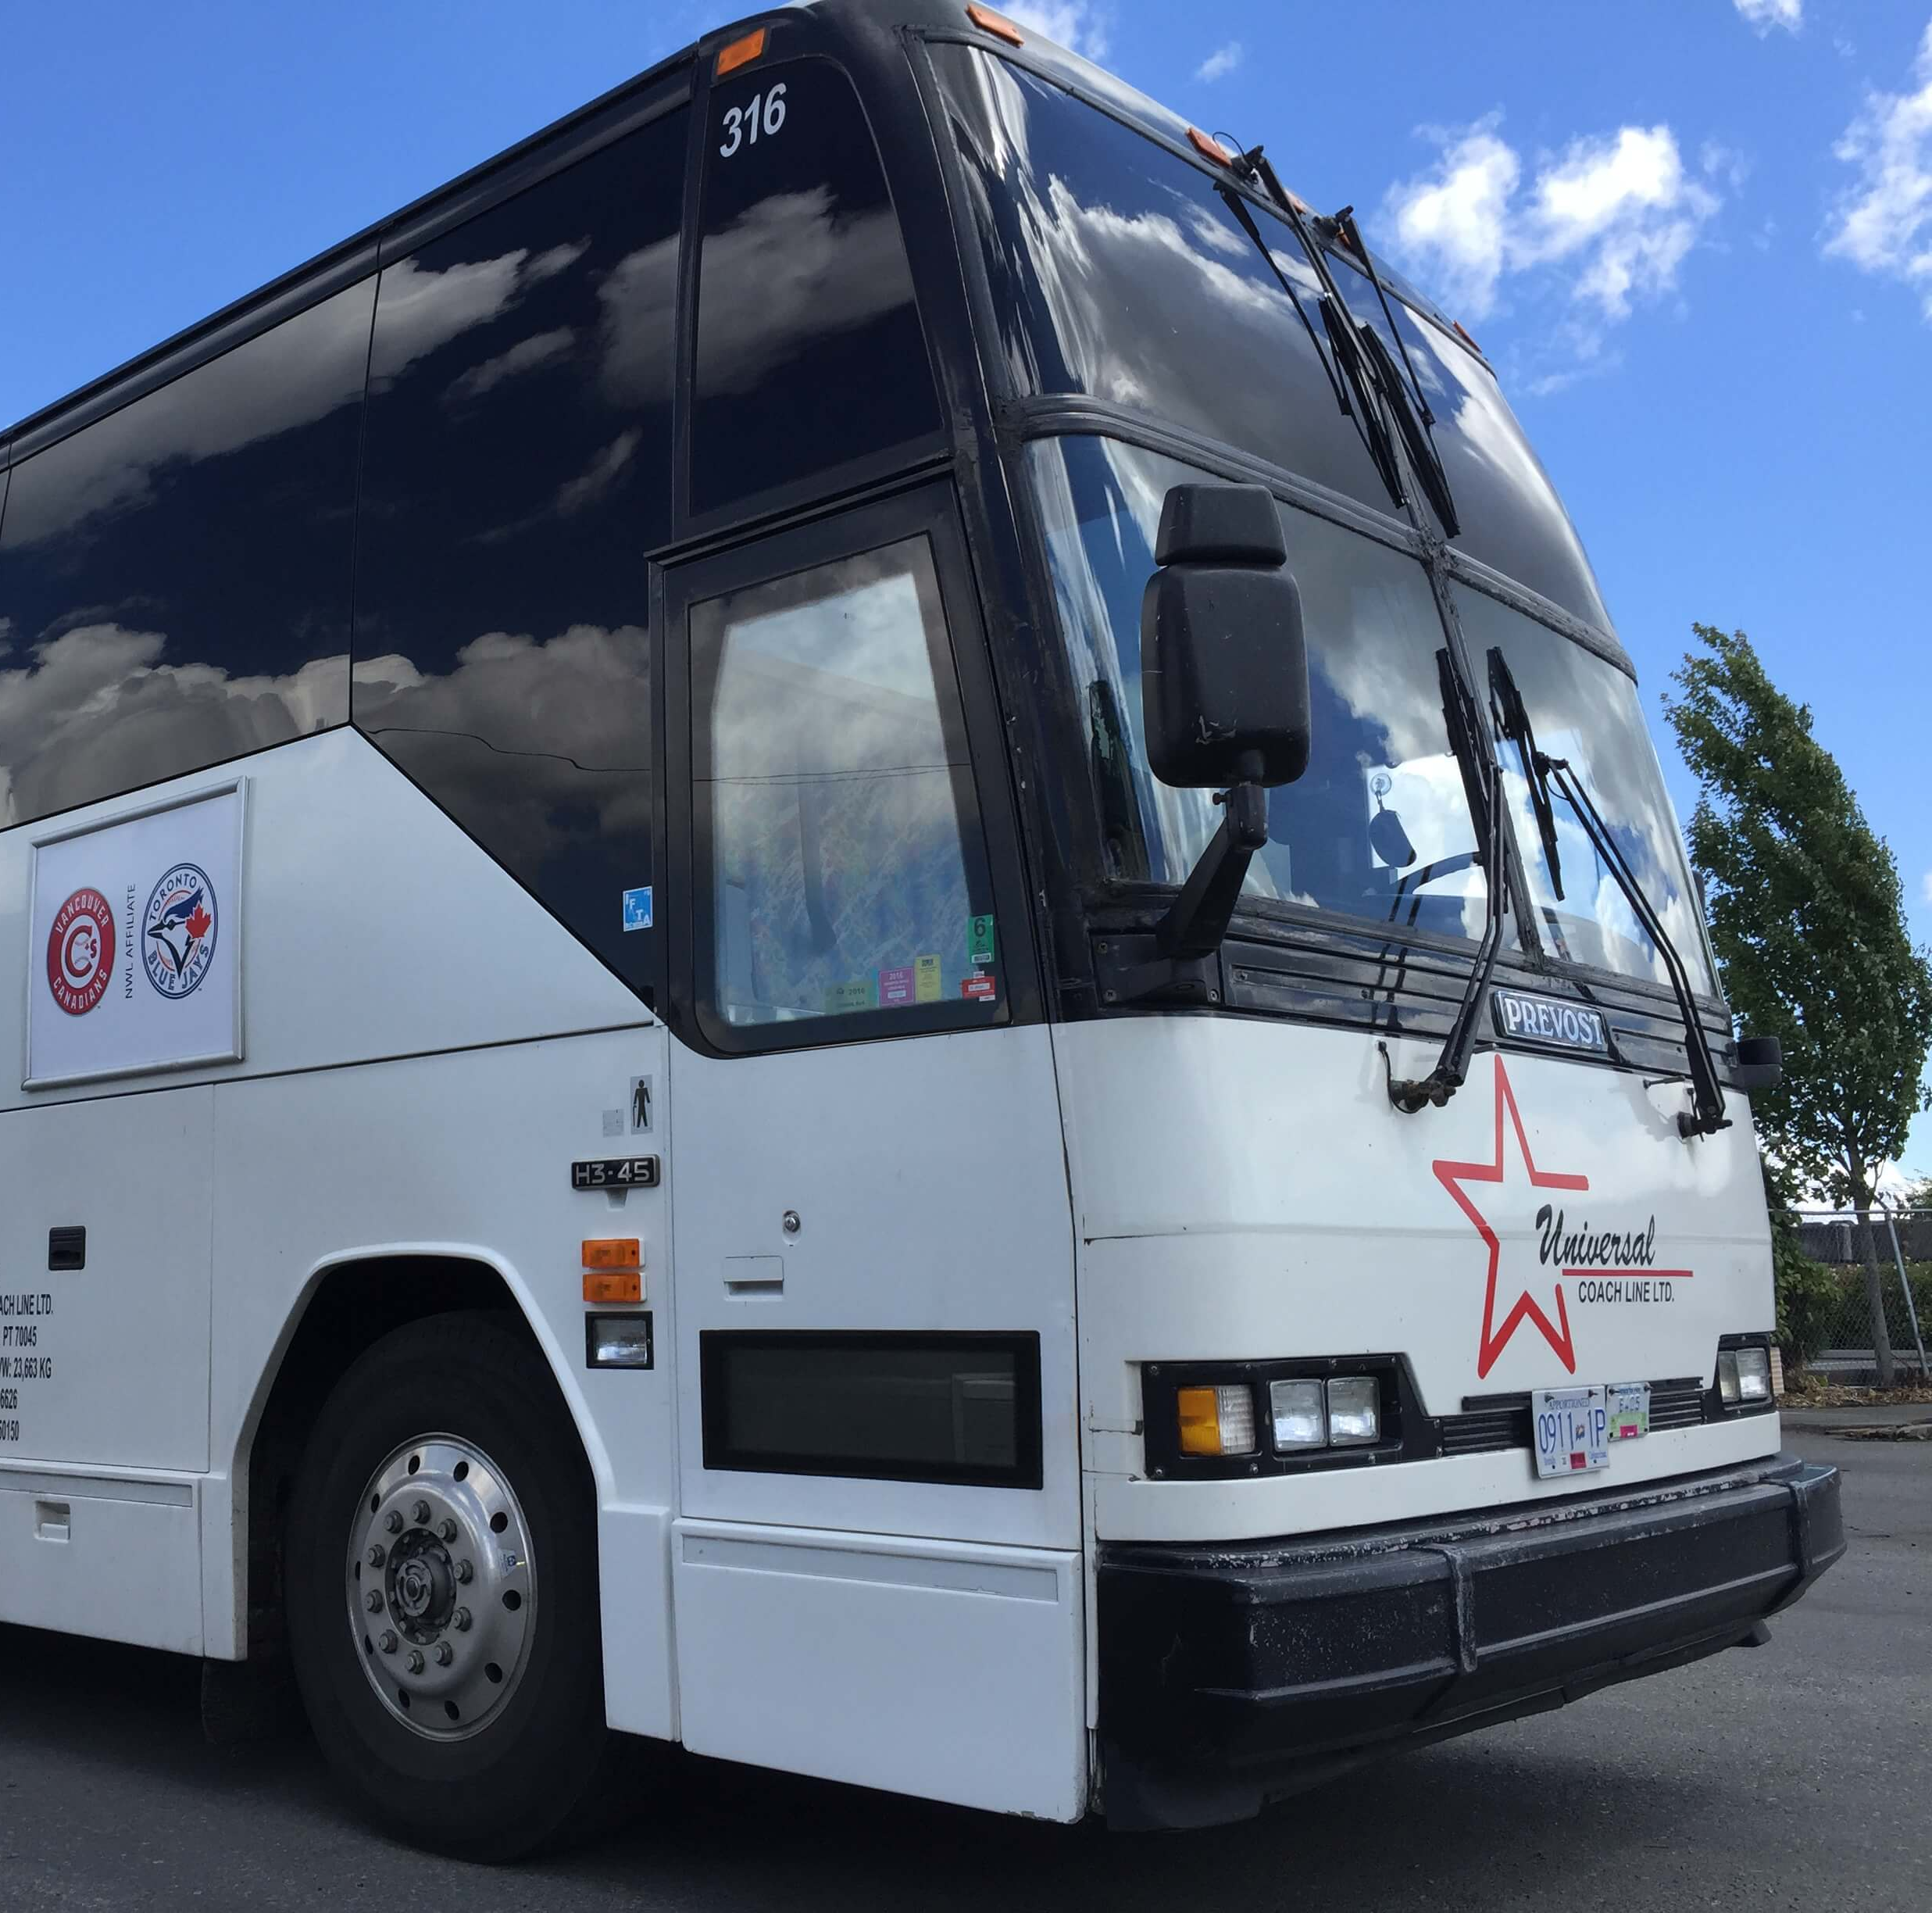
Transportation
Students are permitted to use their own means of transportation to get to the banquet.
For any students interested that have not secured a ride can purchase a spot on a bus for an additional $20. These spaces will be sold at the time of ticket sales.

Slide 5
Red Carpet
Date: May 23, 2025
Time: 3:15-4:30
Location: Delview Secondary GYM
Information:
Students arrive at the school and head to the small gym where they will be organized for the red carpet. Students will have their name called and walk down the red carpet in the large gym. Family and friends will be able to watch the red carpet walk inside the GYM. A grad group photo will be taken in the GYM prior to leaving for the dinner/dance.

Slide 6
Red Carpet walk sign-up
When purchasing tickets for the Diner/Dance students will be asked to sign-up for their red carpet walk
Options: walking on the red-carpet solo, in pairs or a group of three (no more than 3 people are permitted to walk down together because of the limited space).
Students will be asked to provide a short write-up to be read when walking.
Example: “Josephine’s dress is made by the House of Dior”, or “Michael’s tuxedo is inspired by OO7”, or "Katy and Kim met at Gibson Elementary in grade 2 and have been best friends since!”

Slide 7
CLC/CaPSTONE
BEFORE PURCHASING BANQUET TICKETS
ALL 20 CLC ASSIGNMENTS MUST BE BE COMPLETED
CAPSTONE PRESENTATION MUST BE COMPLETED AND PRESENTED
ALL CLC AND CAPSTONE REQUIRMENTS MUST BE COMPLETED PRIOR TO PURCHASING A TICKET

Slide 8
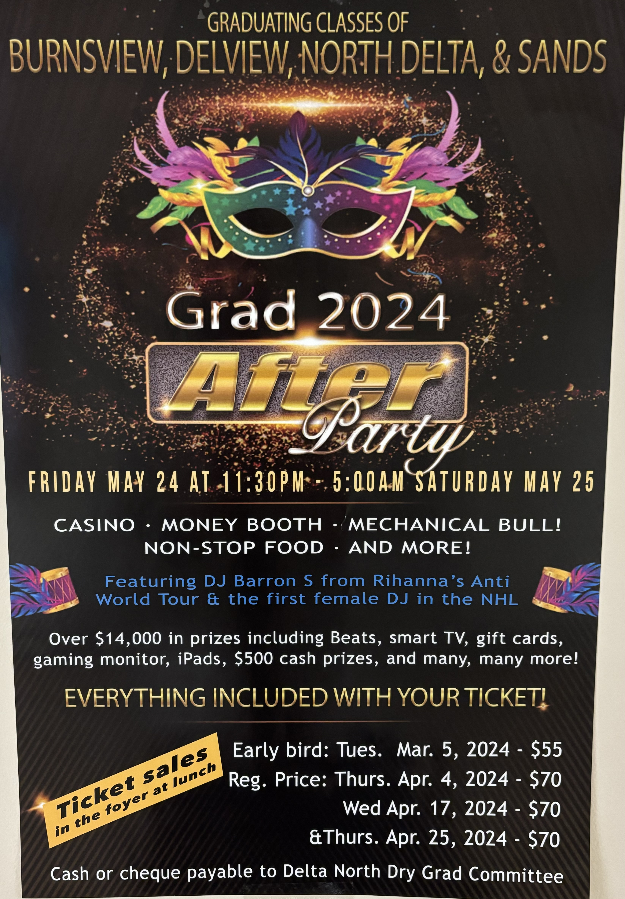
Dry Grad
Dry Grad 2025
Date: May 23-24
Time: 11:30pm-5am
Location: North Delta Rec. Centre Information: More information can be found on the Delview webite (Dry Grad Information for Families). Please email the Dry GradCommittee
drygrad.deltanorthend@gmail.com for any questions or inquiries.

Slide 9
Valedictory-2025
Date: June 23, 2025
Time: 7:00pm (Grads arrive at 6pm)
Location: North Delta Secondary School
Tickets: Will be handed out to students with cap and gowns in June
More information regarding our valedictory will be sent out to families closer to the event.

Slide 10
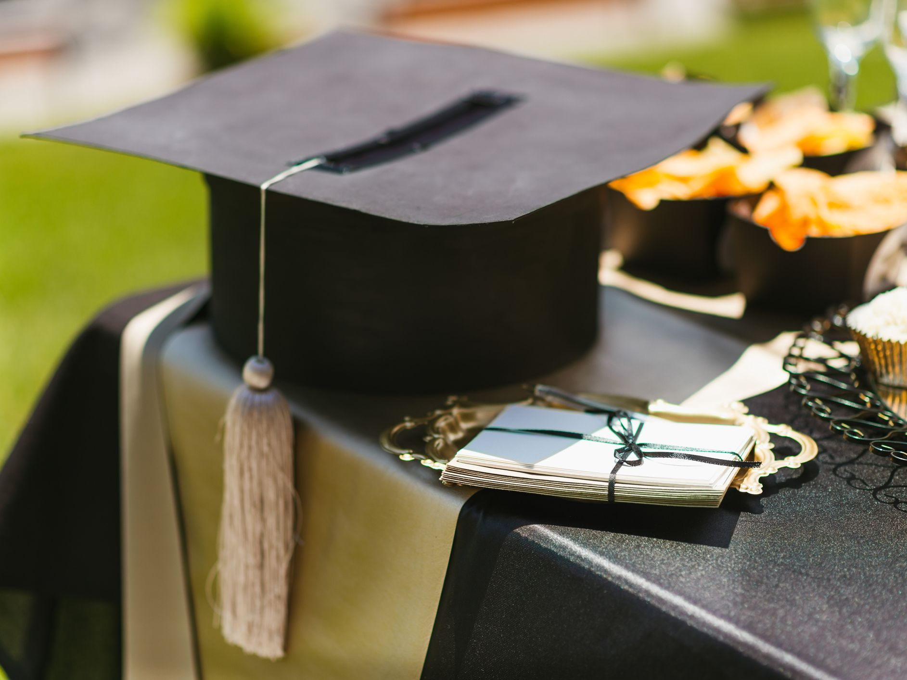
Grad Write-Ups- Valedictory
All Grade 12’s will receive and email containing a link and QR codes will be posted in classrooms for the write-ups for commencement.
Any student who does not submit a comment by the deadline will have a ‘canned’ comment read as you cross the stage.
If you have any questions regarding valedictory comments, please see Ms. Minhas in the library.
Grade Write-Up Link
John would like to thank his friends and family for all their support in helping him through school.
John Doe has been accepted into UBC where they will be pursuing a degree in business administration

Slide 11
Grad Agreement
Grad agreement must be completed by all grads prior to participation in grad events
Any students that did not attend the boat cruise will be provided with a copy at the time they purchase tickets.

